Slide 1
Ensemble Samplers with Affine Invariance
Jonathan Goodman & Jonathan Weare
(2010)
E. S. Martiny and A. K. Ravn
Niels Bohr Institute

Slide 2
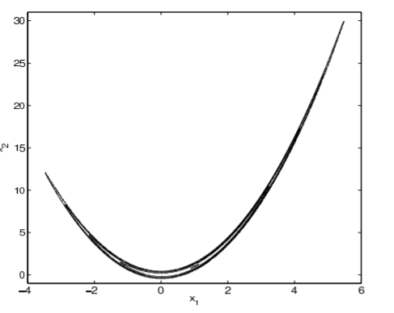
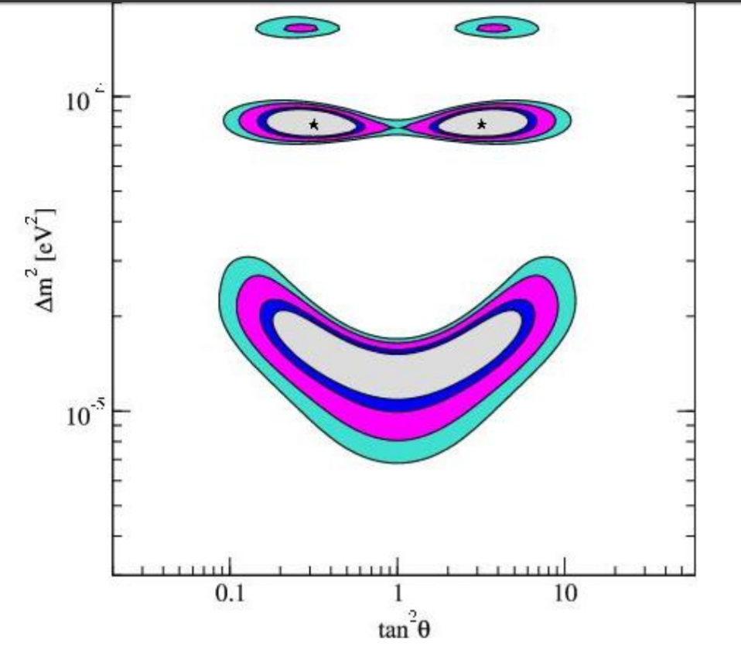
The Problem
Notes:
How to not optimize the optimization.

Slide 3
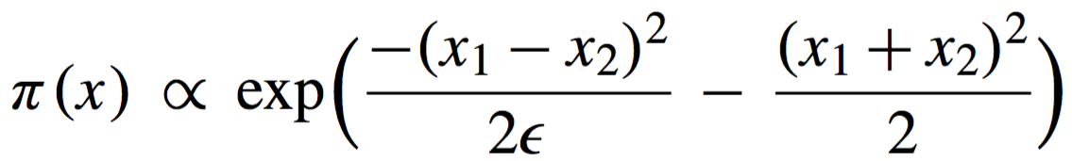
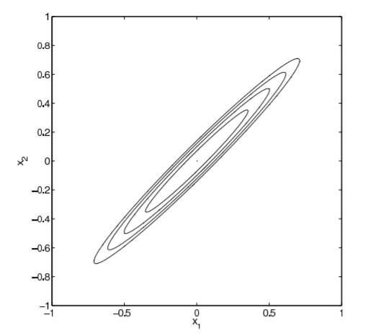



Affine invariance
An affine transformation is a transformation on the form Ax + b that preserves points, parallel lines and parallel planes.
A move is affine invariant iff the same affine transformation performed before the move algorithm or after the move algorithm produces the same result.

Slide 4
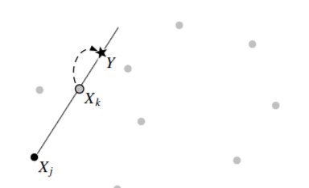
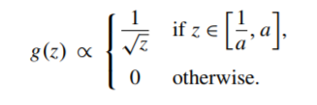
Stretch move
The stretch move uses another walker in the ensamble to make the proposal for the next move.
All possible proposals lie on the line that contains both walkers positions in parameter space.
Notes:
Symmetry:g(z^-1) = z g(z)
symmetric: Pr(X_k(t) → Y) = Pr(Y → X_k(t))
Metropolis-Hastings acceptance prob: min{ 1, Z^(n-1) π(Y) / π(X_k(t)) } ← detailed balance for Markov chain is satisfied.

Slide 5
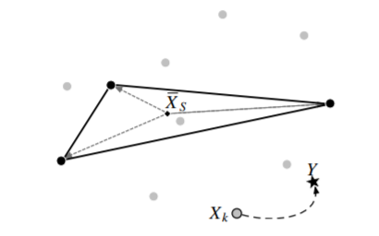


Walk move
The walk move uses at least two other walkers in the ensemble (sub-ensemble) to make a proposal for a new move.
The proposal adds a stochastic variable with same covariance as the sub-ensemble to the current position of the walker.
Notes:
symmetric : Pr( X → X + W = Y ) = Pr(Y → Y − W = X )
Metropolis acceptance probability: min{ 1, π(Y)/π(x) } ← detailed balance is insured.

Slide 6
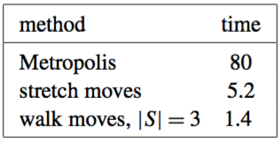
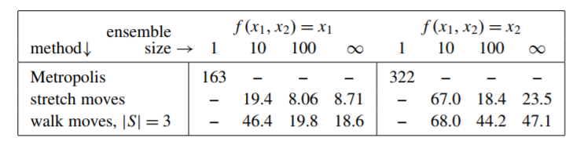
Performance
Rosenbrock distribution test
Sampling from invariant distribution of the stochastic Allen-Cahn equation.
Notes:
They also tested sampling from the invariant distribution of the stochastic Allen-Cahn equation.
They discretized the integral to 100 trapezoids.
In this problem the walk move had the best performance time.

Slide 7
Ending remarks
These algorithms works the best when the walker ensemble is large.
The emcee python package utilizes a stretch move algorithm optimized for parallelization to compute MCMCs.
In the next big release of emcee (v3.0) they are going to implement the walk move along with other ensemble samplers, as well as single-particle Metropolis.
Notes:
large ~ 100 makes a good approx of the density

